Slide 1
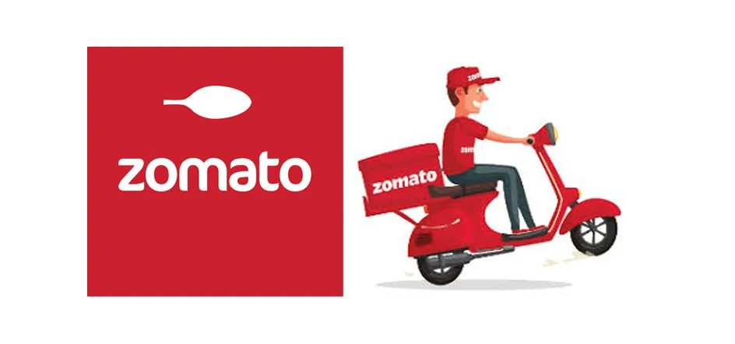
Zomato data set analysis
By Juhi and Manshi

Slide 2
OVERVIEW
Zomato is an online food delivery and restaurant discovery platform that provides users with information about restaurants, menus, and user reviews. With the help of Power BI, we can analyze the data on Zomato’s Bangalore restaurants and create a report to visualize the findings.
The Zomato report will begin with an overview of the data, highlighting the number of restaurants, top restaurant chains, top cuisines, and top locations available on the platform. We will then dive into the analysis by creating visualizations on the top-rated restaurants, cuisine popularity, and average cost for two people.
Furthermore, the last dashboard on the report is based on an interactive restaurant finder that allows users to search for restaurants based on location, cuisine, meal type, and dishes liked. This feature will enable users to make informed decisions on where to dine, based on factors such as location, rating, and cuisine preference.
In conclusion, the Power BI report on Zomato’s restaurant data analysis and restaurant finder feature will help users to make informed decisions about dining out. It will provide insights into the most popular cuisines and restaurants in each location, as well as offering an interactive tool to find the best restaurant options.

Slide 3
INTRODUCTION
The dataset is about Zomato Bangalore Restaurants. The objective of analyzing the Zomato dataset is to get a fair idea of the current situation of the foodservice industry in Bangalore. We also would want to identify the various factors affecting different types of restaurants in different places, the popular cuisines, meal types and most liked dishes. Bengaluru is a food hub and is a place where you can enjoy almost every Indian cuisine and plenty of international cuisines like American, Continental, Mexican, Middle — Eastern, Chinese, Japanese, Korean, Thai, Vietnamese and many such wonderful cuisines from all around the world.
Data Resources / References:
https://www.kaggle.com/datasets

Slide 4
DATA CLEANING & TRANSFORMING
Data Cleaning and Transformation:
The data source was a CSV file consisting of a dataset with 17 columns. On Power BI Desktop we click on “Get Data” from the CSV file and proceed onto transforming/cleaning the data in the Query Editor. By default, the first row is promoted to headers and the column types are changed.
1. I removed the following columns since I would not be using them as a part of this analysis: reviews_list, menu_item, listed_in(city).
2. Cleaning was done in predominantly in Excel and small portion in Power BI (Power Query Editor). I removed unquantifiable values from the “rate” column that included “/5”, blank values, “-”, and “NEW”.
3. Ensure that the restaurant name column does not contain any special characters like / , /n, ~,` etc.,
For restaurants with names like “Café” the “é” is observed to be replaced with special characters like “ƒ”,” Â”,”©”. I performed multiple replace operations on the column “name” to handle the same. Around 78 restaurants proper name were google searched and looked up on to the column.
4. Duplicates were checked for the entire dataset and if any were removed.
5. Data was trimmed and aligned properly.

Slide 5
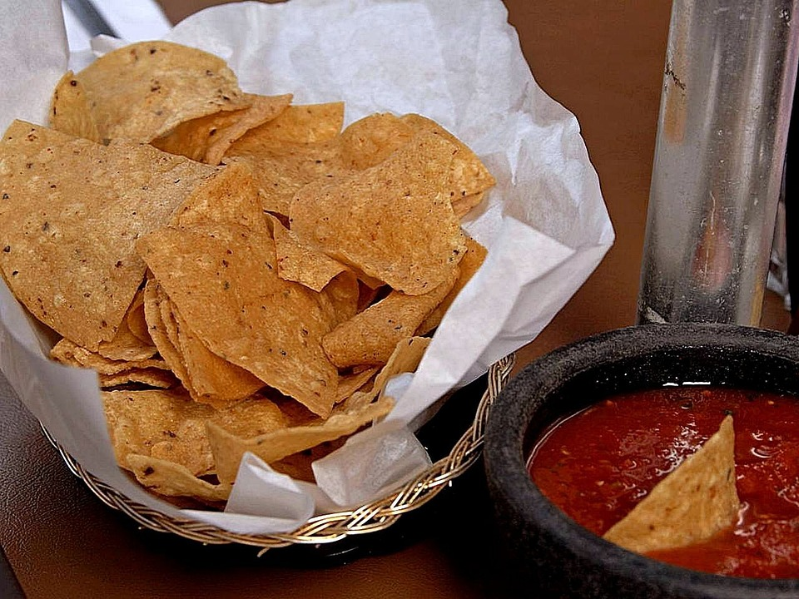
Analysis and Modelling
Observations:
There are around 51k rows in the dataset initially.
Different addresses have the same restaurant names (restaurant chains).
The same address applies to multiple restaurants at the same location.
Each entry in the dataset is already at a location level i.e., a single location per restaurant name and address but if we analyze the columns like “rest type”, “dish liked” and “cuisines”, they have multiple entries concatenated in a single column. We would want to extract the individual values for these to perform analysis like the top cuisines, top dishes liked or restaurant types.
Multiple entries are present for a name-address combination differing in the column “listed_in(type)”.

Slide 6
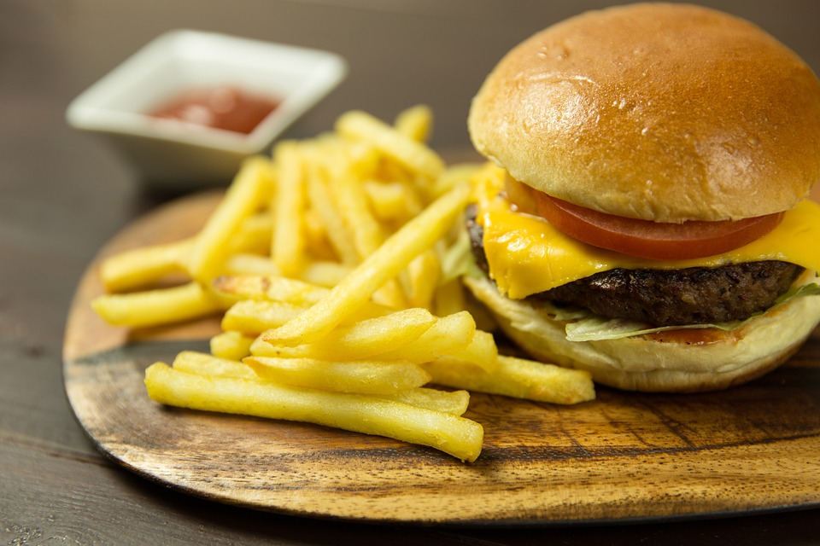
Data Wrangling, Manipulation and Transformation
Part 1:
1. It would not be correct to take the total count of “names” to count the number of individual restaurants or the count of restaurants falling under a restaurant chain. We can create a new custom column called “Restaurant Address” which is a concatenation of the fields “name” and “address” to do uniquely identify a restaurant at a location.
2. I also uppercased and trimmed the “restaurant name” and “restaurant address” columns for consistency and for easy reference.

Slide 7
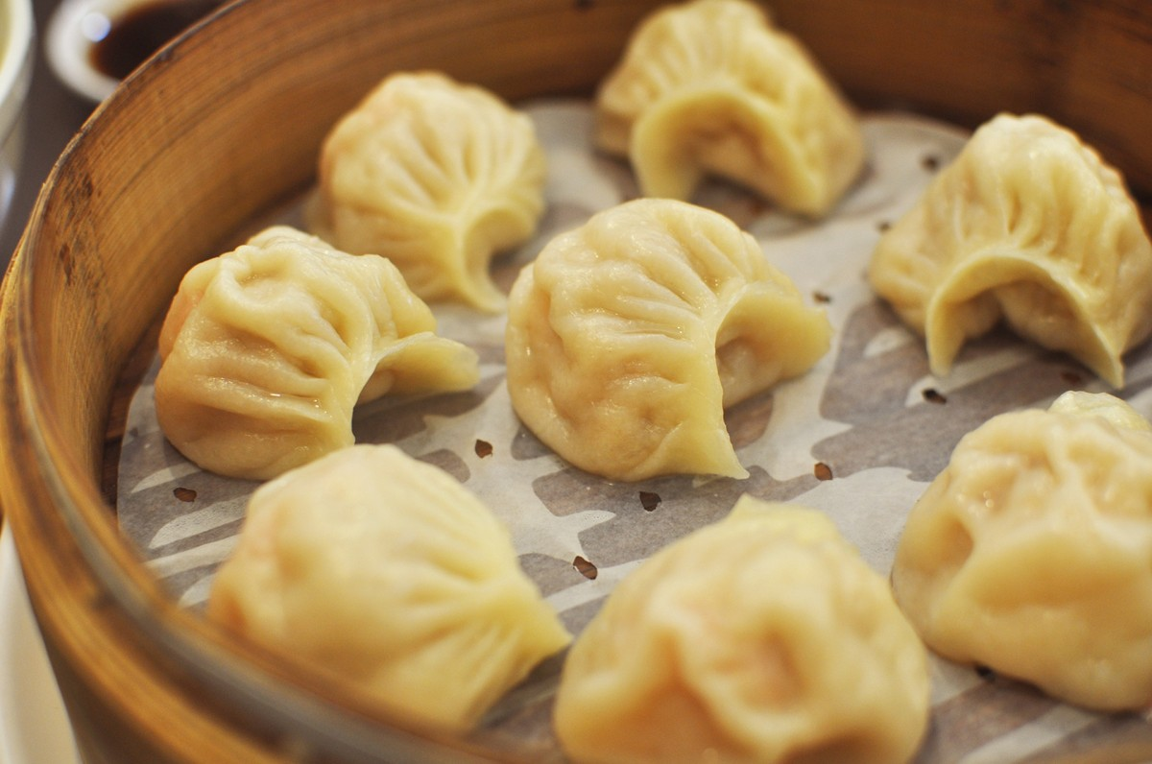
Part2:
1. We need to extract the unique values from the columns rest_type, cuisines, and dishes_liked.
2. Select all the columns in Excel, go to Data and select “Table Range” to go to the power query editor.
3. Right-click on the rest_type column and click on “Split Column by Delimiter”. Make the selections as below by selecting a comma as the delimiter and split the data into rows.

Slide 8

4. Repeat the same process for columns, “dish liked” and “cuisines”.
Select the complete data set and trim before starting dashboarding and analysis.
The dataset is now clean and ready for analysis and dashboarding. I have listed the dashboards created for the analysis below and insights found from them.

Slide 9
Home page
. Top Restaurants analysis where you have slicers for meal types and visualizations on top 10 restaurant chains, top locations by avg rating, top 10 cuisines, restaurant count by location, Distribution by meal type, a simple bar chart with percentages showing online orders and table booking options.
Dishes Liked analysis where you have slicers for meal types and visualizations for top 10 locations and dishes liked.
.Cost & Rating analysis where you have slicers for meal types and visualizations for Distribution Cost for 2 People, Number of Restaurants by rating distribution, Rating Distribution by Table Booking and Online Orders.
Restaurant selection page has options for you to select your favourite restaurants from the choices you give in the options mentioned. You have slicers for meal types and visualizations for Table, Slicers for Location, Cuisines, Meal Type and Dish Liked, Slicers for Table Booking and Online Order, Slicer for Cost for 2 People, and Cards for Avg Cost for 2 People, Average Rating and Total Votes.

Slide 10
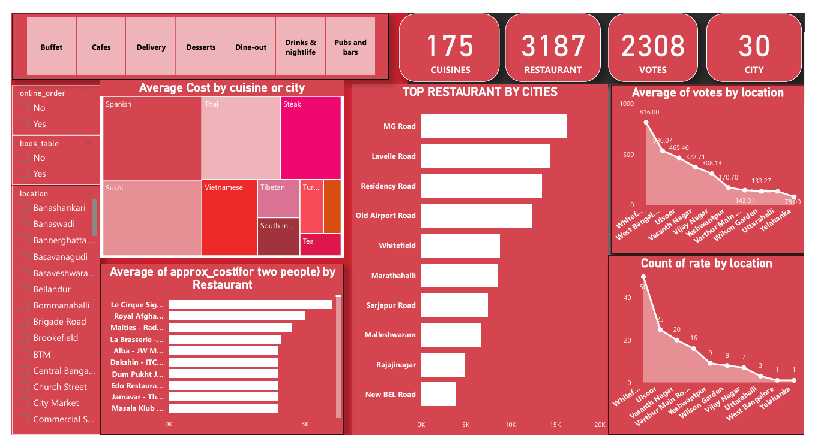

Slide 11
HIGHLIGHTS
The most available cuisine is North Indian followed by Chinese, Fast-food and South Indian.
A huge percentage of restaurants offer online orders but very few offer table bookings.
Maximum no of restaurants (44.65 %) falls under the Meal Type Delivery and 38.06% restaurants fall under Dine-Out.
The number of restaurants is dense towards central Bangalore. You can use the map visualization provide to zoom in and zoom out to get a much clearer idea about the location and number of restaurants available at that particular location.
NOTE: All the visualizations on the report are interactive (Cross Filtering is applied to every visualization applicable) and can be used to filter the other and gain specific insights and valuable information

Slide 12
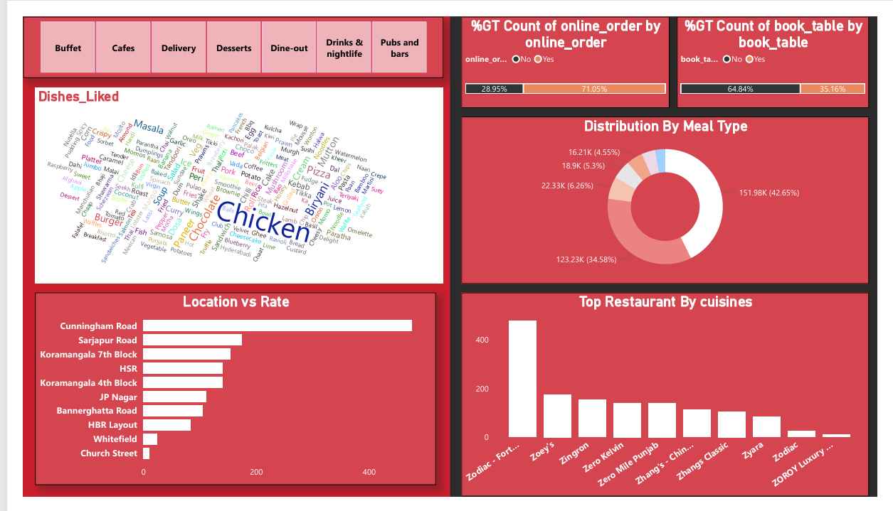

Slide 13
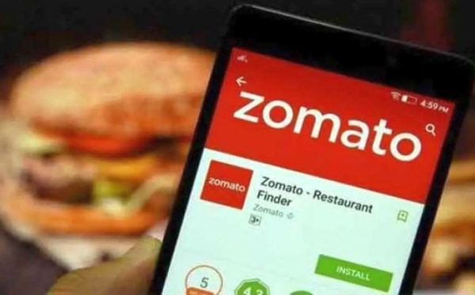
KEY FINDINGS
1. Chicken, Burger, Chocolate, Peri-Peri, Sandwich, and Pizza are among the most popular dishes for Meal Type Cafes
2. Lavelle Road, Sankey Road, St. Marks Road, Koramangala 3rd Block, Koramangala 5th block are the top 5 locations and have the highest average rating of restaurants overall.
3. The two visualizations can be filtered down by selecting a Meal Type from the slicer available.

Slide 14
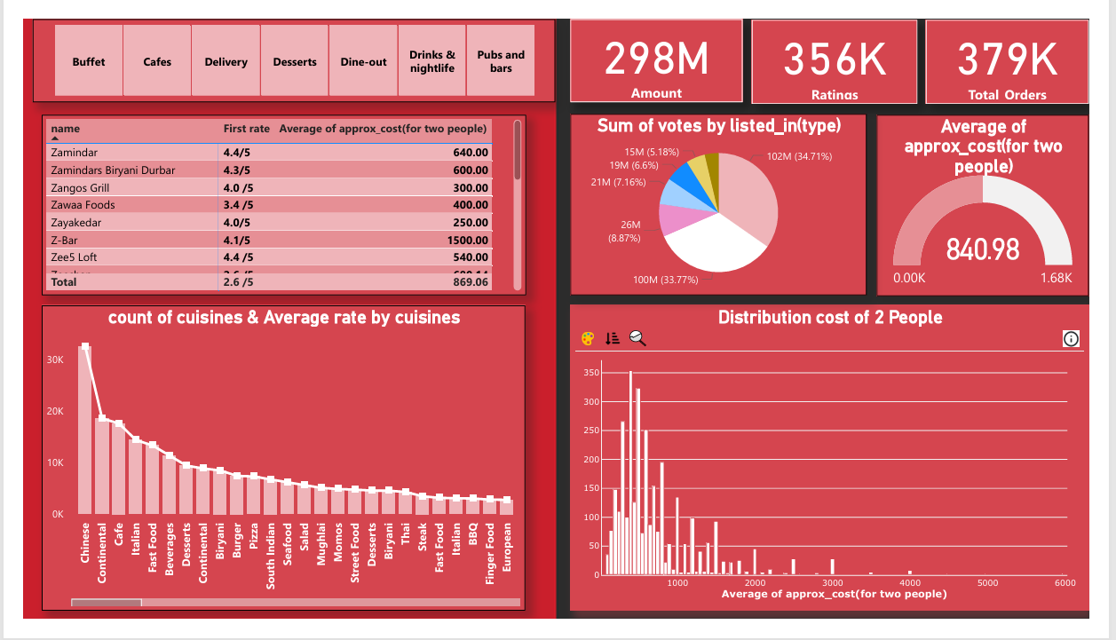

Slide 15


